Slide 1

Leveraging Data to Revolutionize Airline Operations
TRANSFORMING GLOBAL AVIATION THROUGH ADVANCED ANALYTICS
Presented by Group 1: Muhammad, Eyasu, Anushree, Beha

Slide 2



Introduction and Problem Statement
Airline Industry Challenges
Environmental Impact
Untapped Potential of Data
Costly flight delays, cancellations, and operational inefficiencies negatively impact airline profitability and customer satisfaction.
Disruptions in flight schedules lead to increased fuel consumption and carbon emissions, contributing to environmental concerns.
Leveraging big data tools and techniques to analyze comprehensive airline data can uncover valuable insights for optimization and competitive advantages.
By addressing the key challenges and capitalizing on the opportunities presented by data-driven insights, airlines can improve operational efficiency, enhance the customer experience, and gain a competitive edge in the industry.

Slide 3


Work Distribution
Muhammad Maqsud Hussain
Eyasu Deresa
Anusri Das
Beha Shirshekar
Solution Architecture, Flight Status Analysis, International Travel Flow Analysis, Project Documentation and Presentation Deck Preparation
Passenger Demographics Analysis, Solution Description and References
Airport Performance Analysis, Tools Used and Presentation Deck Preparation
Conducted intro section and Route Optimization Analysis, Future Works and Project Documentation

Slide 4
Dataset Overview
Dataset Scale
Data Structure
Flight Status Distribution
Total Records: 98,619
Original Fields: 15 core attributes
On-Time: 32,846
Flights Time Period: Full year 2022 Scope: 9,062 unique airports Coverage: Global
Added Fields: 5 derived attributes
Delayed: 32,831
Data Types: Mix of categorical, numerical, and date
Cancelled: 32,942
Passenger Demographics
Key Dimensions
Gender Balance: Almost equal
Flight Information: Status, Routes Passenger Demographics: Age, Gender, and Nationality
Age Range: 1-90 years, Avg: 45.5 years
Airport Details: Names, Countries, and Continents

Slide 5



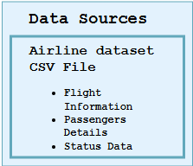







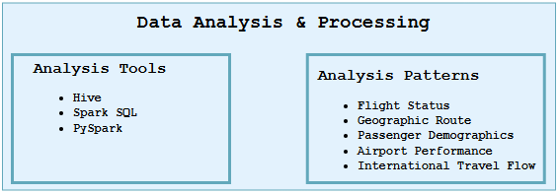






Data Pipeline Architecture

Slide 6

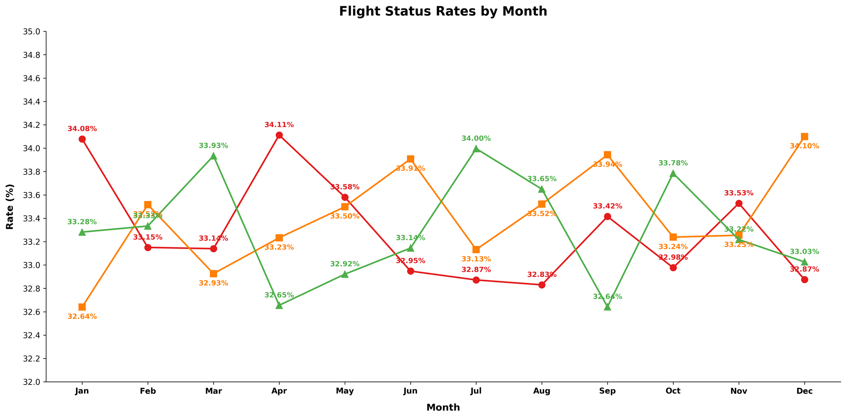


Insight 1: Flight Status Trends
Number of Flights by Status
On-time Performance
Delay Rates
Cancellation Rates
Winter Operations
On-time performance peaks in March (33.93%) and July (34.00%), indicating better operational efficiency during these months.
Delay rates are highest in April (34.11%) and gradually improve through the summer months.
Cancellation rates steadily increase throughout the year, reaching a peak of 34.10% in December, likely resulting in substantial rebooking costs and customer dissatisfaction.
The winter months pose significant operational challenges, with both delays and cancellations tending to increase during this period, directly impacting the bottom line.

Slide 7
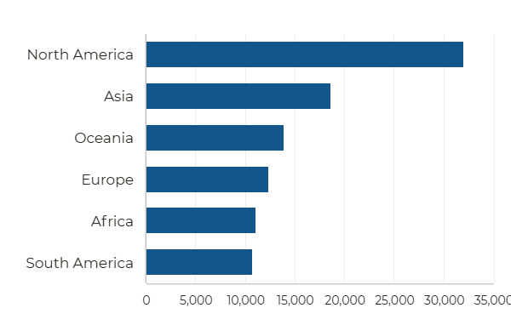
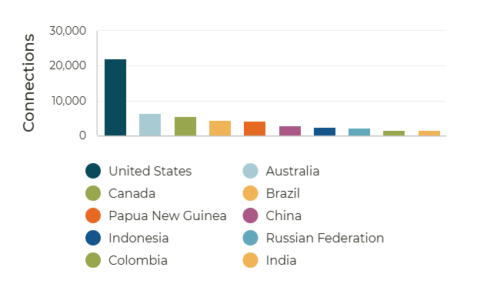






Insight 2: Geographic Route Optimization
Continental Connectivity
Top 10 Country connection by Frequency
32,033
18,637
13,866
12,335
11,030
10,718
North America's dominance in connectivity could influence decisions related to market focus, resource allocation, or transportation hubs.

Slide 8
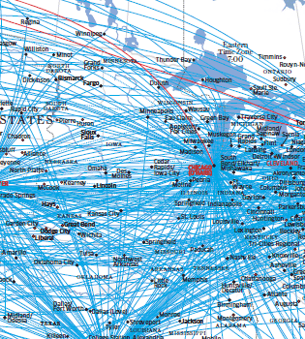
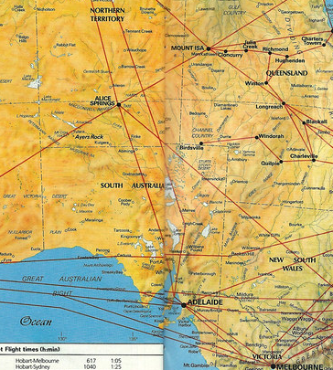

The Top 3 Countries Connections
United States
Australia
Canada
The United States is the country with the most routes, involved in 22,104 connections.
Australia is the second-highest country with 6,370 routes.
Canada ranks third among all countries with 5,524 routes.

Slide 9



Insight 3: Passenger Demographics
Top 10 Nationalities
Gender
Male
50.29%
Female
49.71%
The data shows a notable dominance of Asian and European nationalities among travelers, with the top four countries being from Asia.

Slide 10
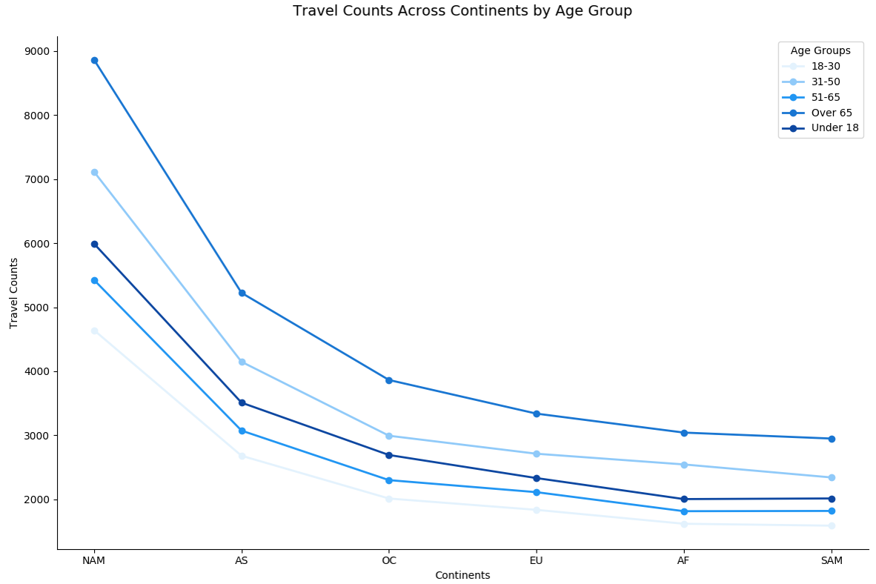





Insight 3: Passenger Demographics
Age Distribution
27,282
21,858
18,547
16,549
14,383
This age distribution highlights that Seniors (65+) form the largest group of travelers at 27.66%, followed by middle-aged adults (31-50) at 22.16%.
North America stands as the top destination for international travels, with seniors aged 65 and older constituting the largest demographic at 32.5%, while Asia follows as a distant second.

Slide 11
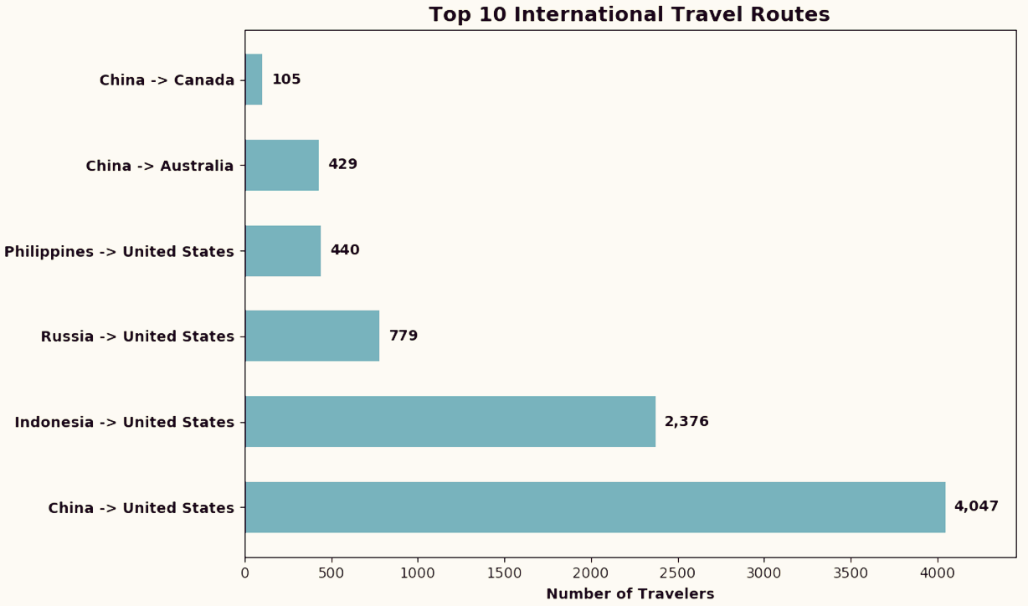






Insight 4: International Travel Flow
Europe
12.6%
Africa
11.4%
Oceania
South America
14.3%
10.9%
Asia
18.3%
North America
32.5%
Continent-level Travel Distribution
Top Route: China–U.S.
The pie chart provides a distribution of international travel by continent, showcasing North America leading with the highest share of 32.5%, indicating its prominence as a key travel destination or origin.
The analysis highlights the China-United States route as the busiest international travel route, significantly surpassing other routes in traveler count. This route displays consistently high travel volume throughout the year.

Slide 12
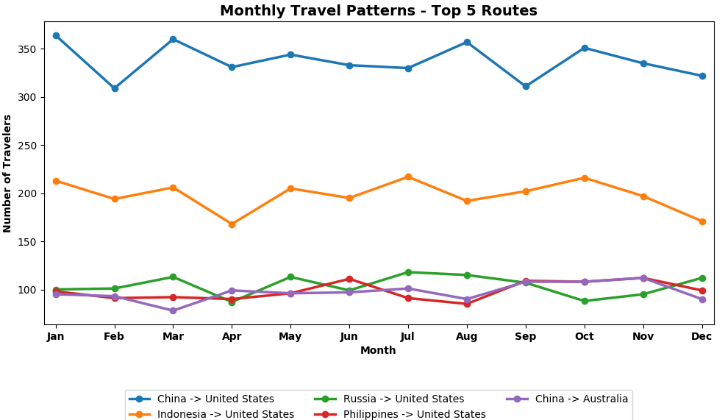
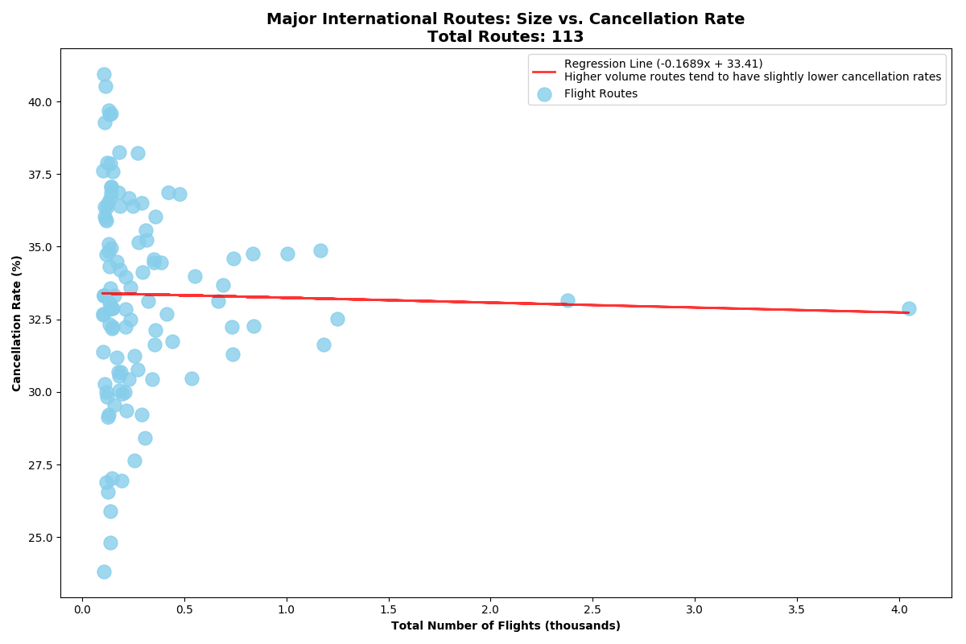
Monthly Travel Patterns and Cancellation Rate
Seasonal Spikes on Select Routes
International routes
While the China-U.S. route maintains a steady high level of travel, other routes, such as Philippines-United States and China-Australia, exhibit more sporadic or seasonal spikes in travel volume.
Analysis of 113 major (for those having > 100 flights) international routes reveals that routes with fewer flights tend to experience higher and more variable cancellation rates (up to 40%), while busier routes maintain more stable cancellation rates around 32-35%.

Slide 13
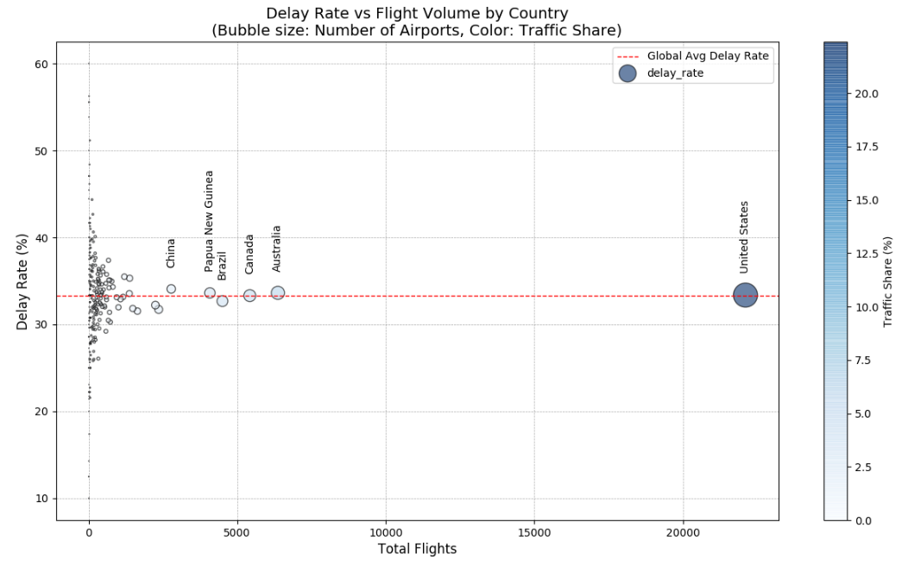
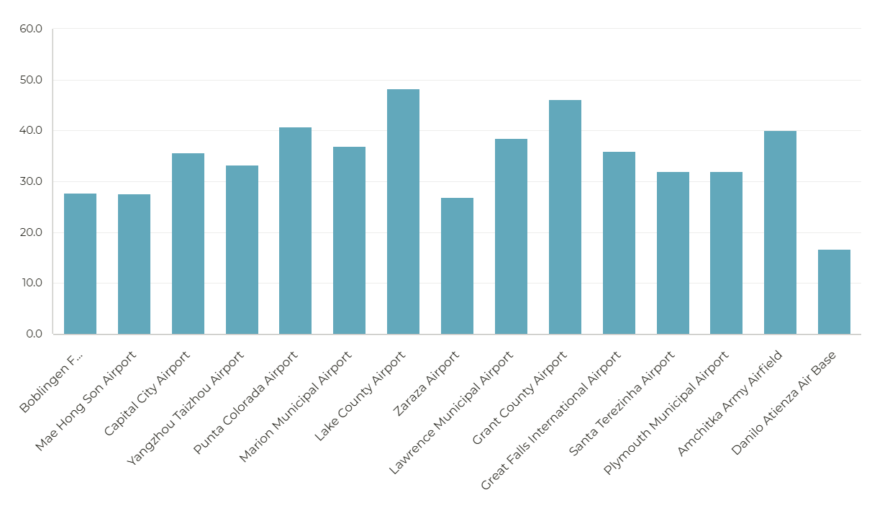
Insight 5: Airport Performance
Delay Rate Distribution
Delay Rates for Top 20 Busiest Airports

Slide 14
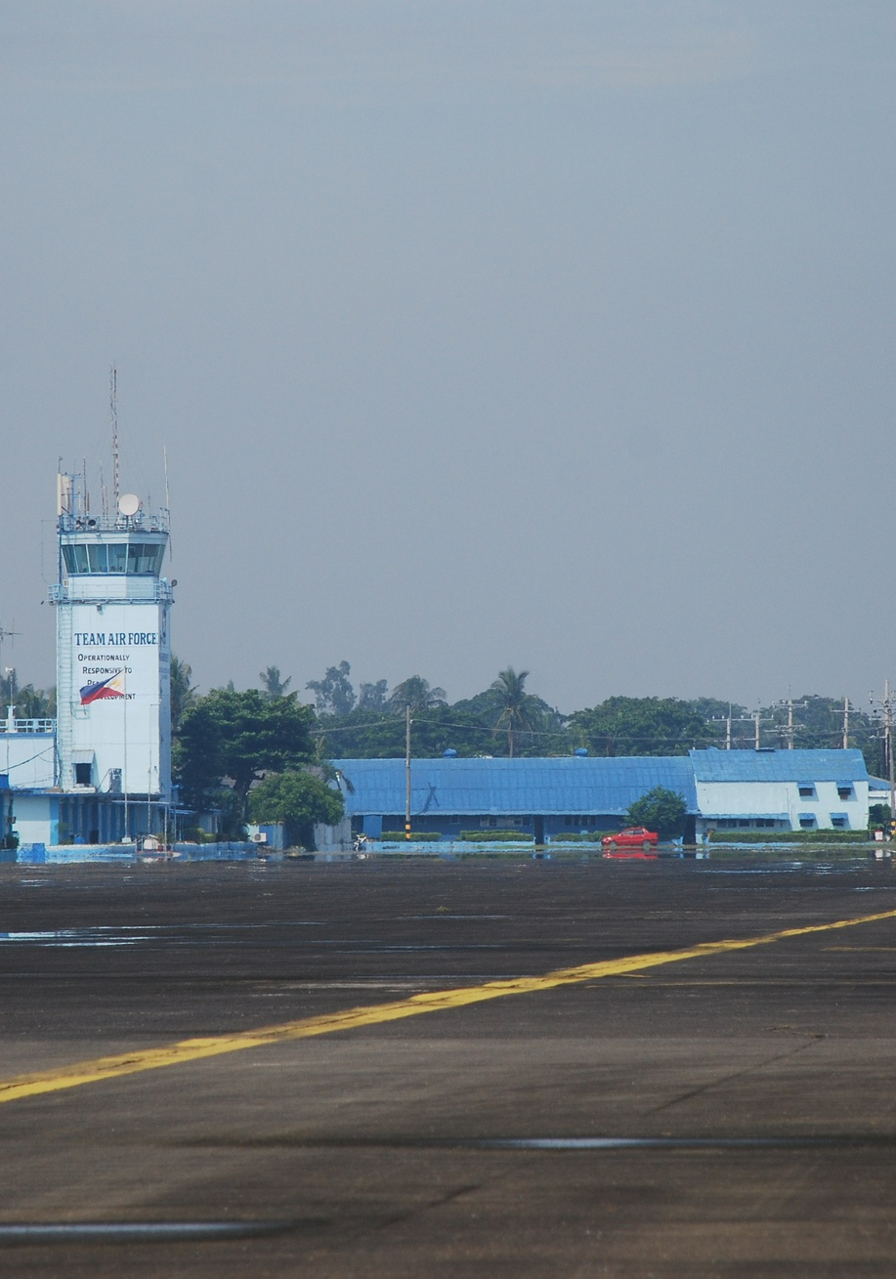
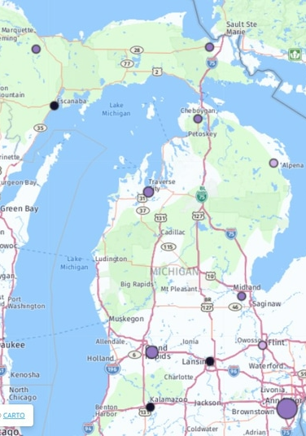


Insight 5: Airport Performance
Danilo Atienza Air Base
Lake Country Airport
Grant County Airport
Delay Rate Distribution
Airport with the best performance and a 16.67% delay rate
Airport with the highest delay rate of 48.15%
Airport with the second-highest delay rate of 46.15%
Airports with delay rates above 40% should be prioritized for improvement

Slide 15




Lessons Learned
Collaborative Development
Data Cleaning and Transformation
Operational Improvements and Customer Satisfaction
Interpreting Insights for Business Impact
The team's collaborative approach, with each member contributing their expertise, enabled a comprehensive and well-rounded analysis of the airline dataset.
Enhanced query efficiency and reduced processing time, leading to more accurate insights on delays and cancellations.
The key insights emphasize the importance of operational improvements and customer satisfaction in the highly competitive airline industry.
Delivered impactful insights that could help airlines enhance efficiency and customer satisfaction.
Implemented a comprehensive big data solution using big data tools to analyze airport performance data, identifying critical areas for operational improvements.

Slide 16
Future Work: Transforming Air Travel Operations
Weather Data Integration
Integrate weather data such as temperature, precipitation, and wind patterns to analyze their correlation with flight delays.
Traffic Control Integration
Integrate air traffic management metrics and runway utilization data to identify system bottlenecks and optimize operations.
Predictive Modeling
Develop machine learning models to predict flight delays and cancellation risks, considering weather, airport performance, passenger behavior, and seasonal trends.
Dynamic Dashboard Development
Create a real-time dashboard that integrates live data feeds, tracks key performance indicators, and monitors flight status for informed decision-making.
Decision Support Features
Implement automated alert systems, resource optimization recommendations, and passenger communication automation to enhance operational efficiency and responsiveness.

Slide 17



An Example of Excellence in the Industry

Slide 18


Thank You!!
We Appreciate Your Attention!

